Slide 1



Transforming Leadership Potential into
Performance through
Serious
Gaming
TOC: April 29, 2013
Cynthia Way Claudia Escribano
DCPAS C² Technologies, Inc.
Notes:
WOW: http://www.youtube.com/watch?v=nJtuCA4vq2g
Wheel of Fortune: http://www.youtube.com/watch?v=1rOw4JQqs6A

Slide 2

Play is the only way the highest intelligence of humankind can unfold.
--Joseph Chilton Pearce
Notes:
iStock #9367206

Slide 3

Are You Ready to Play?
Using gaming has been shown to increase learner’s retention by _________%.
20
(Haystead & Marzano , 2009)

Slide 4
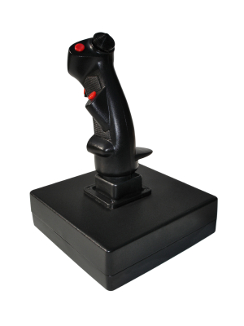
Are You Ready to Play?
Gaming environments need to engage both
_____________&______________ experiences from which
meaning is created.
emotional
cognitive
(Kolb and Kolb, 2010)

Slide 5
Are You Ready to Play?
Gameplay is considered an important method for the development and formation of _________, _________, ________, & _________.
Thinking identities
values norms
(Cole, 1996; Piaget, 1951; Rogoff, 1990)

Slide 6

The creation of something new is not accomplished by the intellect but by the play instinct.
--Carl Jung
Notes:
iStock #11696222

Slide 7

Questions to Explore
How can serious games be used for leadership development?
What are the elements of a game that make it effective for leadership development?
What are best-practice strategies for implementing serious games in leadership development programs?
Notes:
iStock #8250324

Slide 8

Think of a project where you could use a game
Notes:
iStock #3288723

Slide 9

How do the games you played this morning relate to leadership development?

Slide 10








SES Challenge
SES Office
Briefing
Meet with Staff Member
Make Something Happen
Puzzles
Documents
Staffing Issue
Sell
Your
Ideas
Notes:
SES Office—iStock # 16767675
Junk drawer—iStock#20194746
Maze—iStock #11608458
Documents—iStock #4581445
Staff—iStock #23838584
Briefing—iStock #4516916
Staffing Issue—iStock #21584341
Sell Your Ideas—iStock #518332

Slide 11
SES Challenge
SES Office
Briefing
Meet with Staff Member
Make Something Happen
Leveraging Diversity
Emotional Intelligence
Puzzles
Documents
Ambiguity
Strategic Thinking
Conflict Management
Prioritization
Staffing Issue
Sell
Your
Ideas
Creativity and Innovation
Problem-Solving
Decision- Making
Values and Vision, Trust
Integrity and Ethics
Influence
Notes:
SES Office—iStock # 16767675
Junk drawer—iStock#20194746
Maze—iStock #11608458
Documents—iStock #4581445
Staff—iStock #23838584
Briefing—iStock #4516916
Staffing Issue—iStock #21584341
Sell Your Ideas—iStock #518332

Slide 12

GlobalTech Simulation
Help successfully implement a new strategy
Build stakeholder commitment within budget and schedule constraints
Notes:
https://login.experiencepoint.com
9nc4q3j5

Slide 13
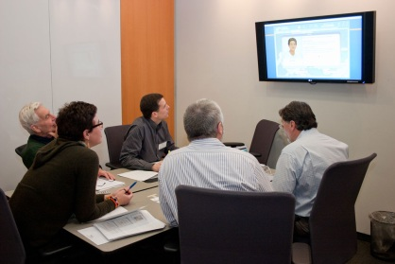
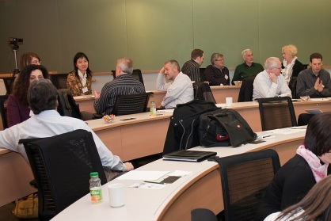
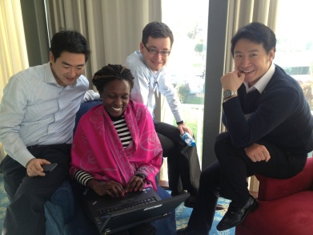
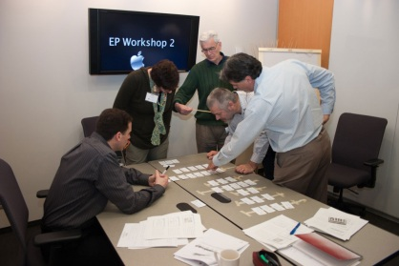
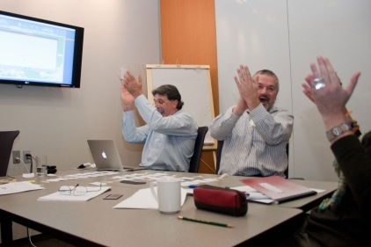
GlobalTech Simulation (cont’d.)
Implement
SIMULATION TEAMS
Case & CAP
GROUP
Introduction
GROUP
Analyze
SIMULATION TEAMS
Plan
SIMULATION TEAMS
Debrief
GROUP

Slide 14
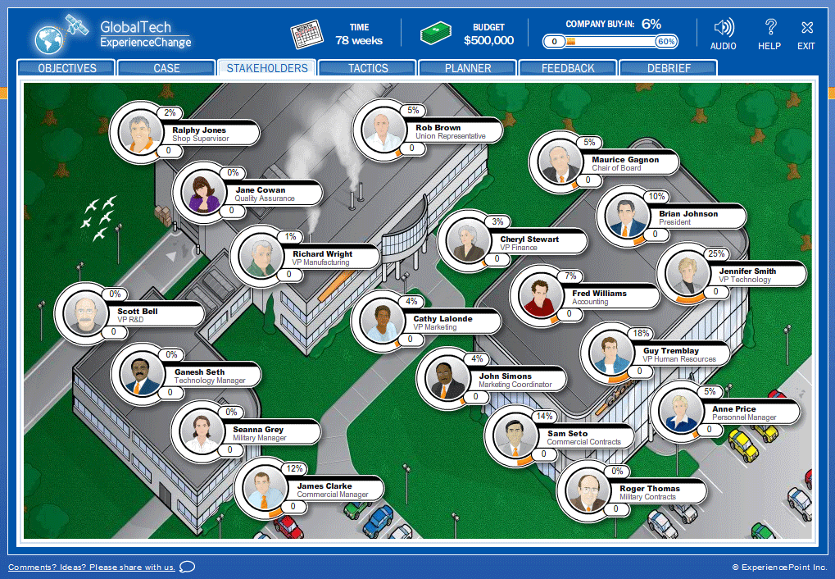
GlobalTech—Analyze

Slide 15
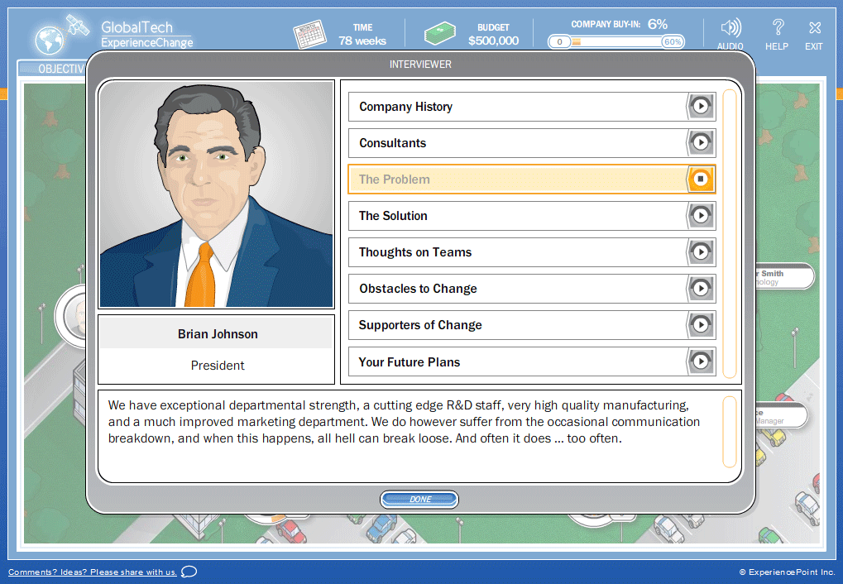
GlobalTech—Analyze (cont’d.)

Slide 16
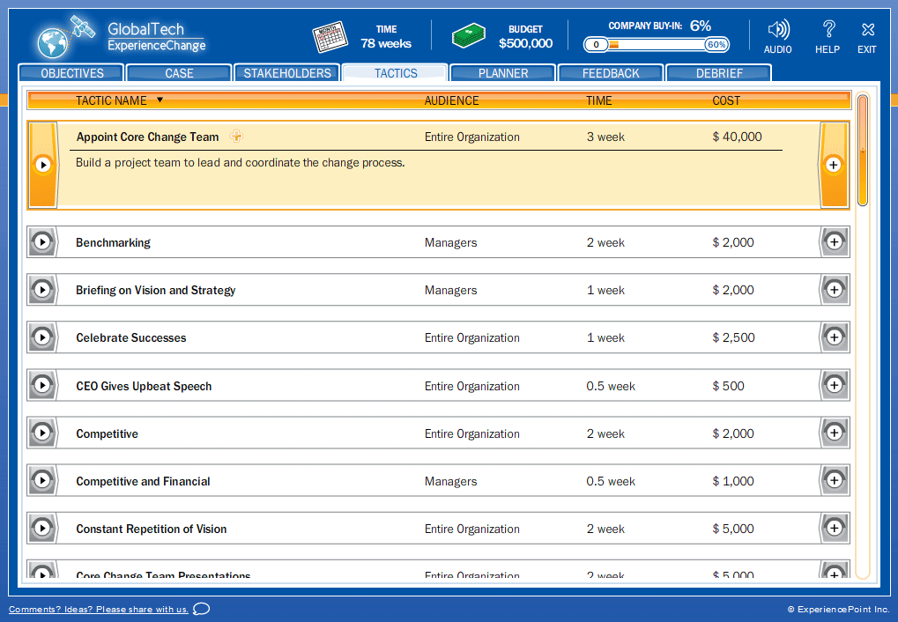
GlobalTech—Plan

Slide 17
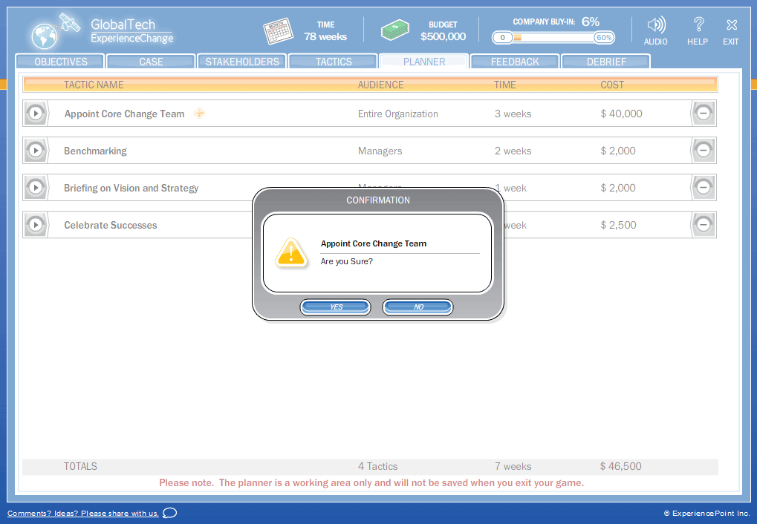
GlobalTech—Implement

Slide 18
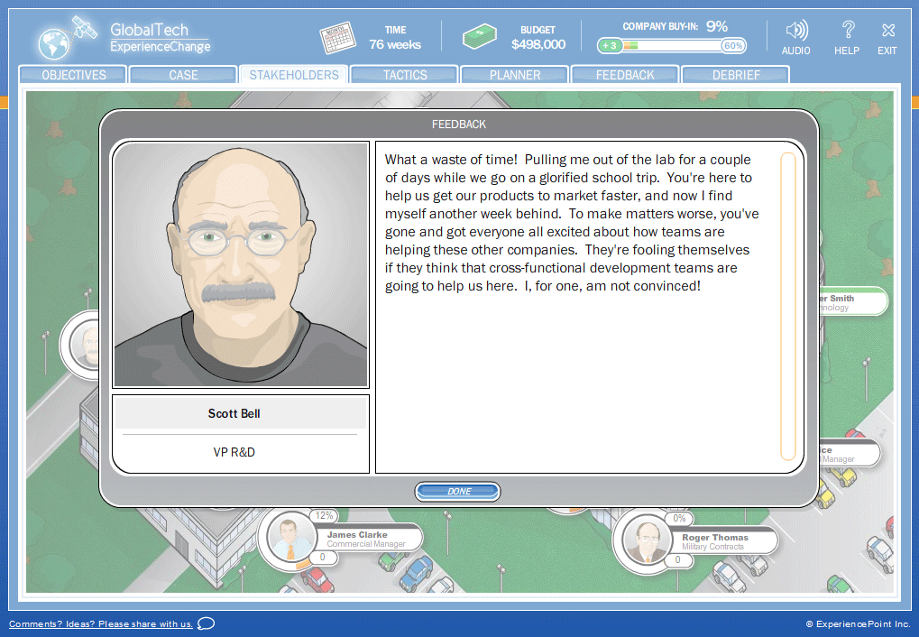
GlobalTech—Feedback

Slide 19
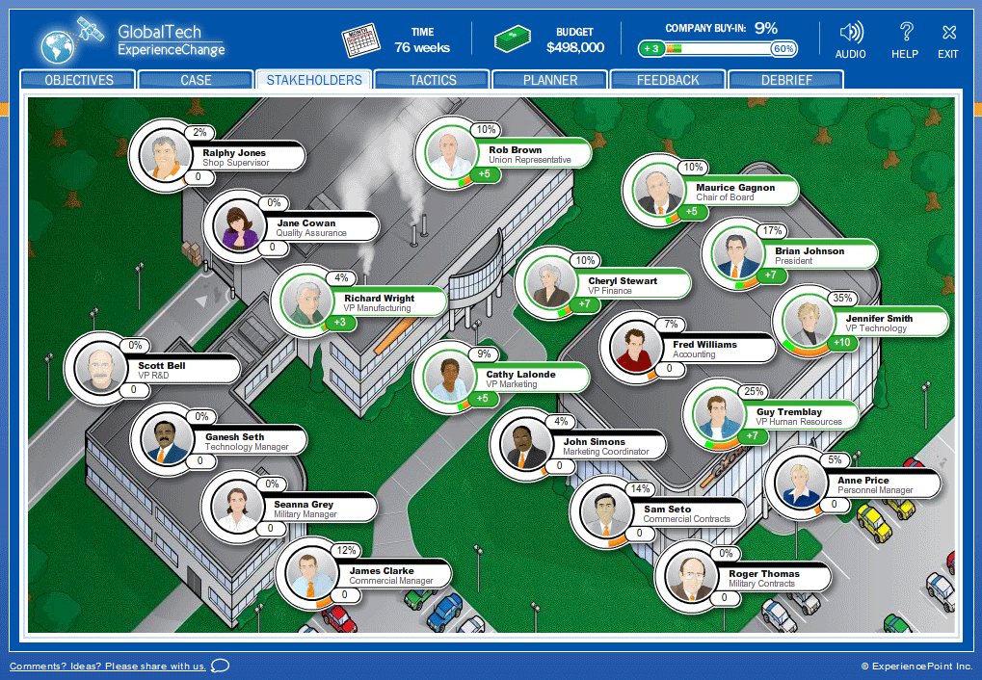
GlobalTech—Feedback (cont’d.)

Slide 20
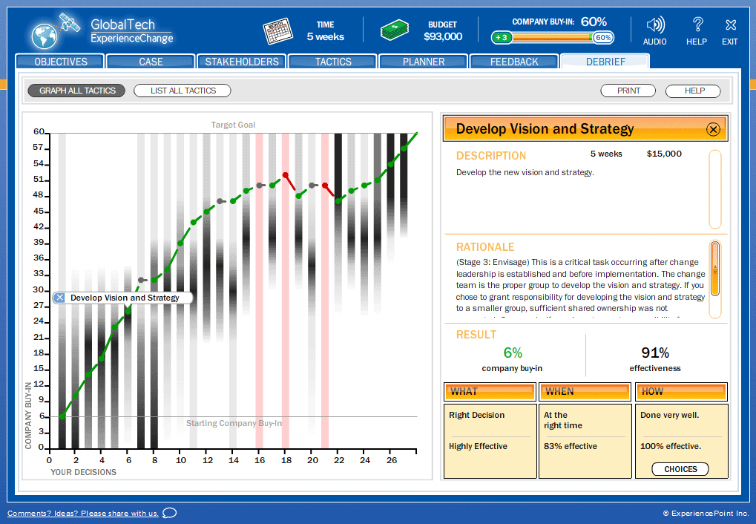
GlobalTech—Results

Slide 21
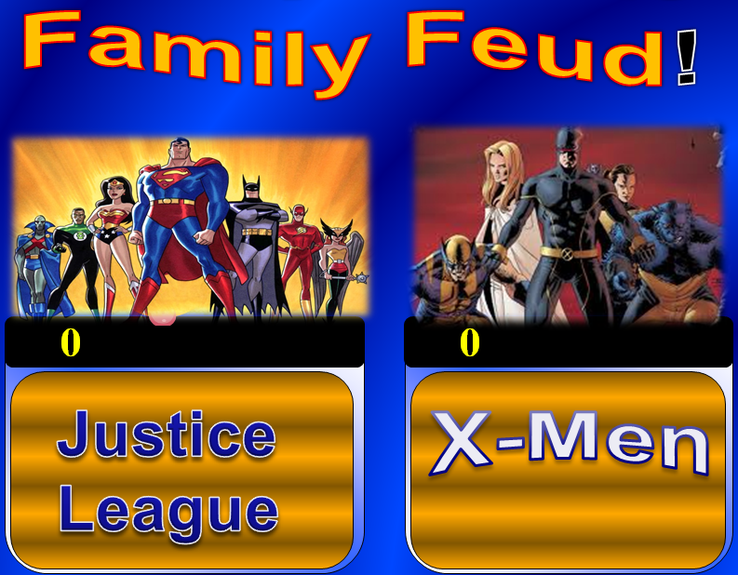
Questions
What are Essential Elements that Make Games Effective for Leadership Development?
What is Top Value in Using
Gaming for Leadership
Development?

Slide 22
The Game Development Process
Working in your groups, use the cards to build the process you’d use to develop your game.
Be prepared to sell your game to the group. You’ll have just 2 minutes.
Then we’ll vote on the most effective process.

Slide 23

GAME OVER...
CONTINUE: Y/N?
And the game goes on…

Slide 24

Thank You
Cynthia Way, Leadership Development Specialist
DCPAS
Phone: 571-372-2062
Email: cynthia.way@cpms.osd.mil
http://www.cpms.osd.mil/
Claudia Escribano, Senior Solutions Architect
C² Technologies, Inc.
Phone: 703-448-7976
Email: cescribano@c2ti.com
www.c2ti.com
AND THE GAME GOES ON...

