Slide 1
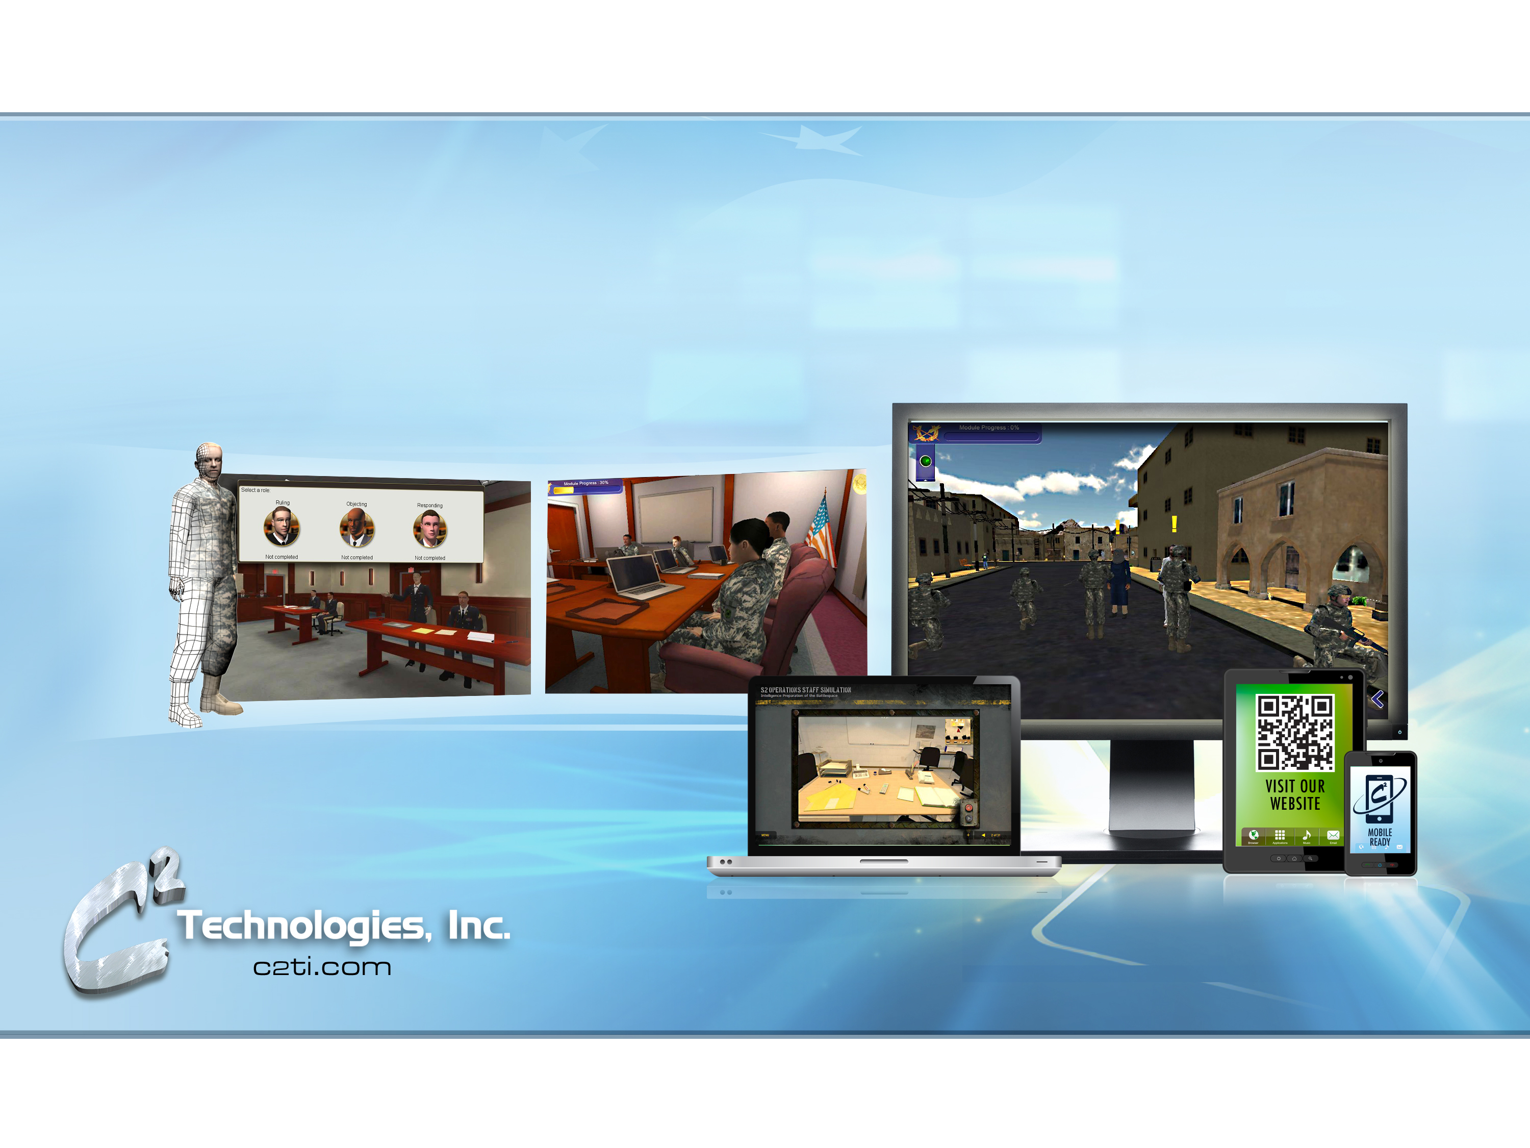
Designing and Developing Interactive Training for Reusability
Notes:
Rodger will get new images

Slide 2
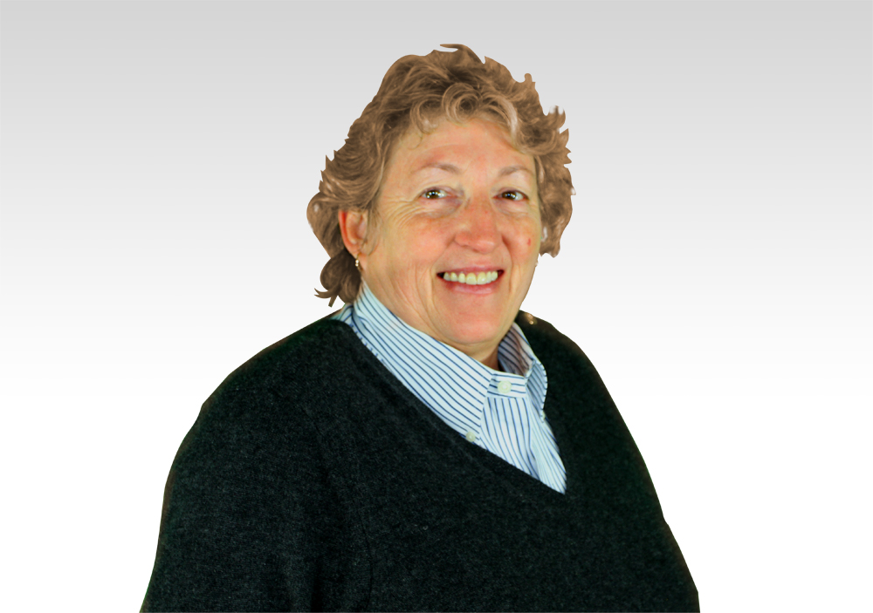
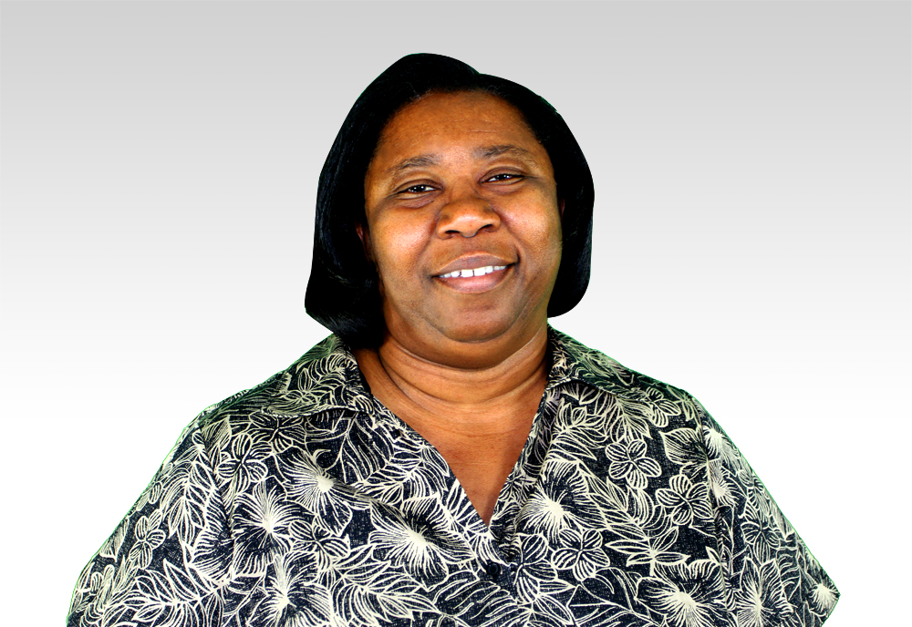
Your Presenters
Gayla Thompson
Darlene Smith
Senior Project Manager
Senior Task Lead
Tidewater Operations Center
Notes:
Each give a short blurb of education and experience

Slide 3
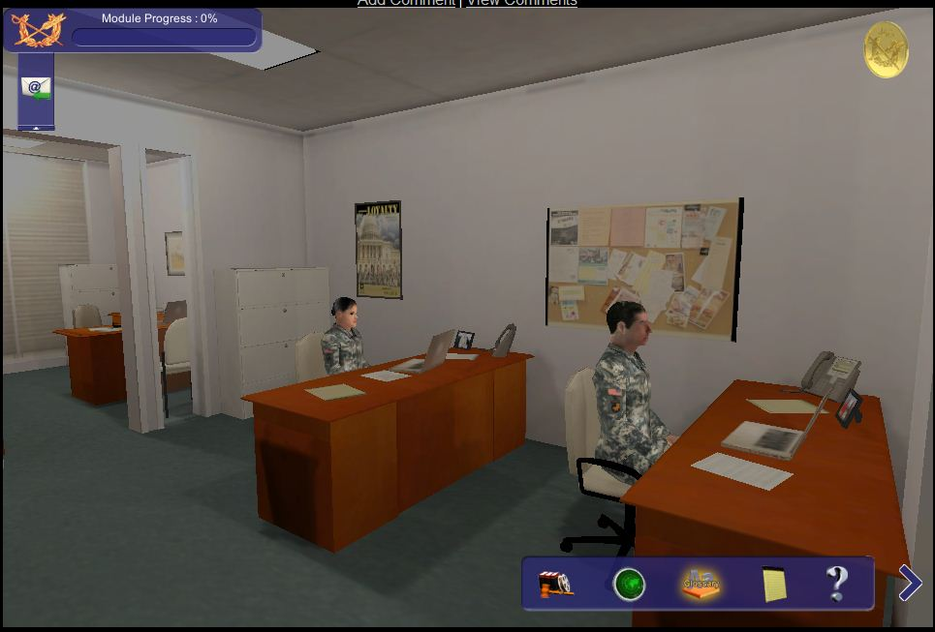
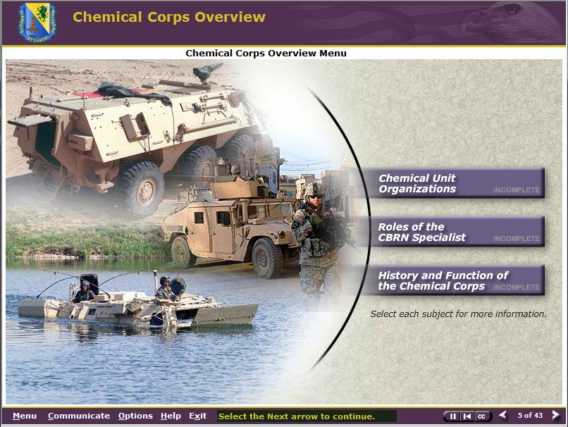
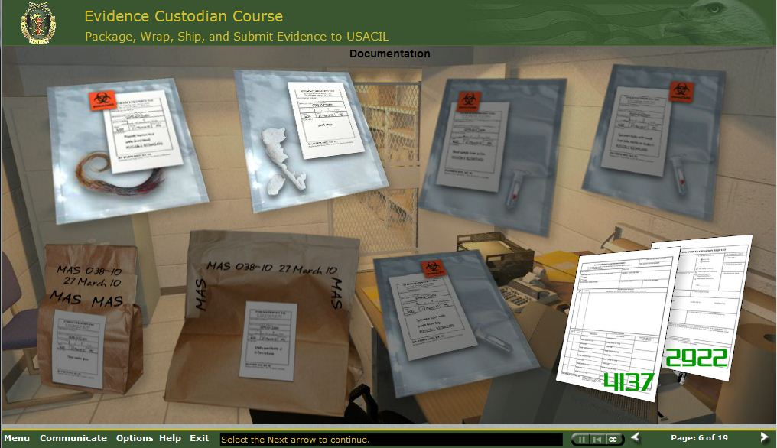
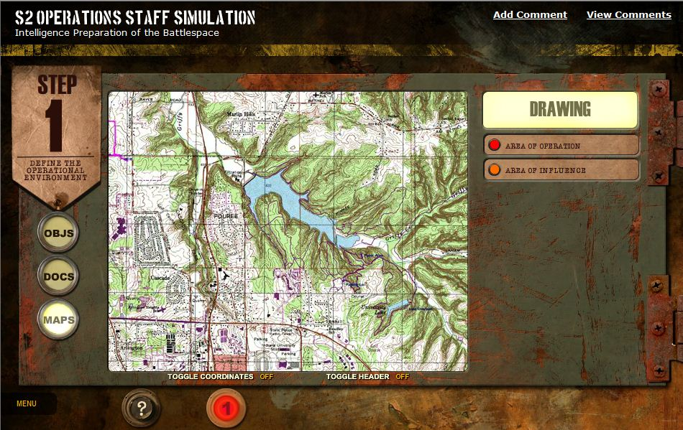
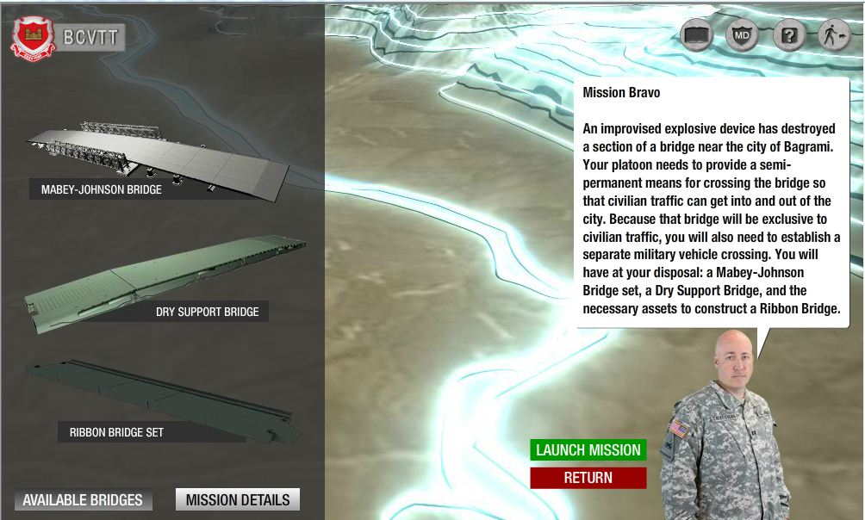
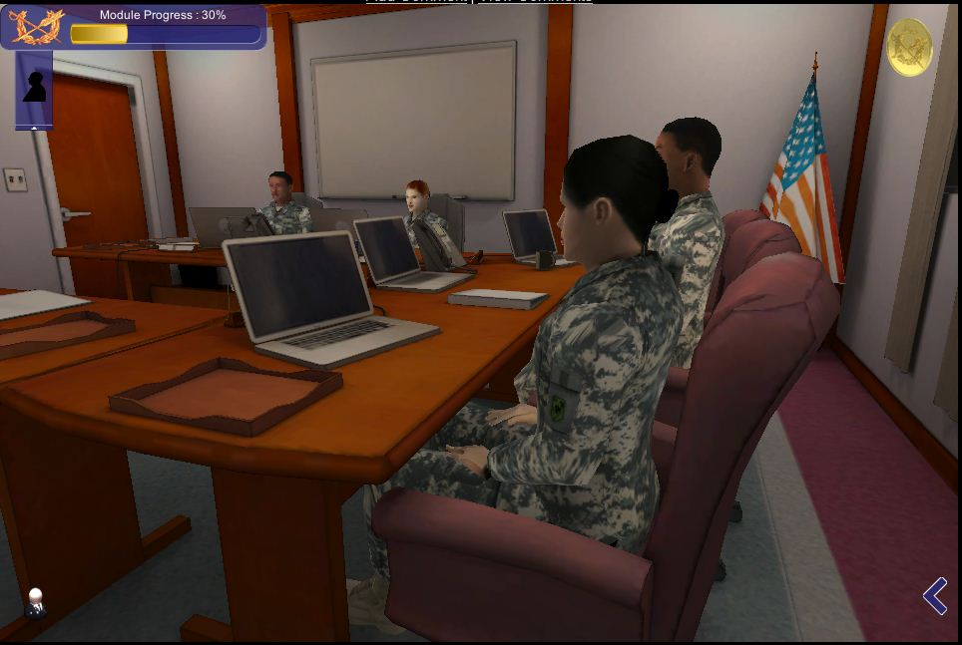
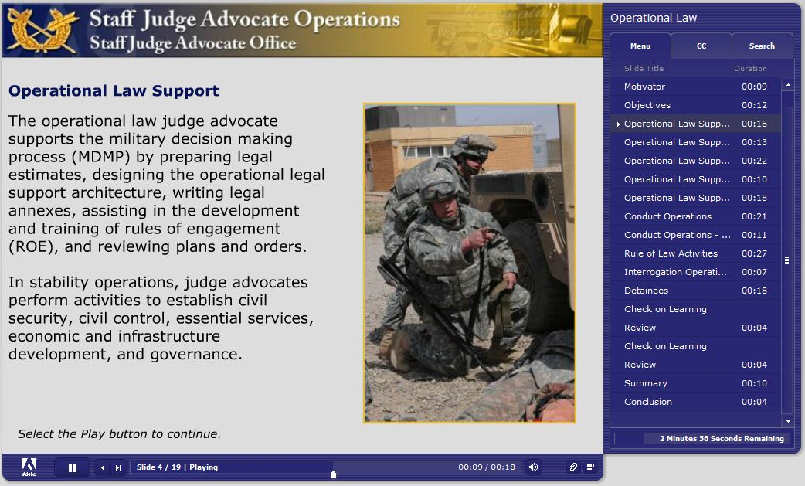
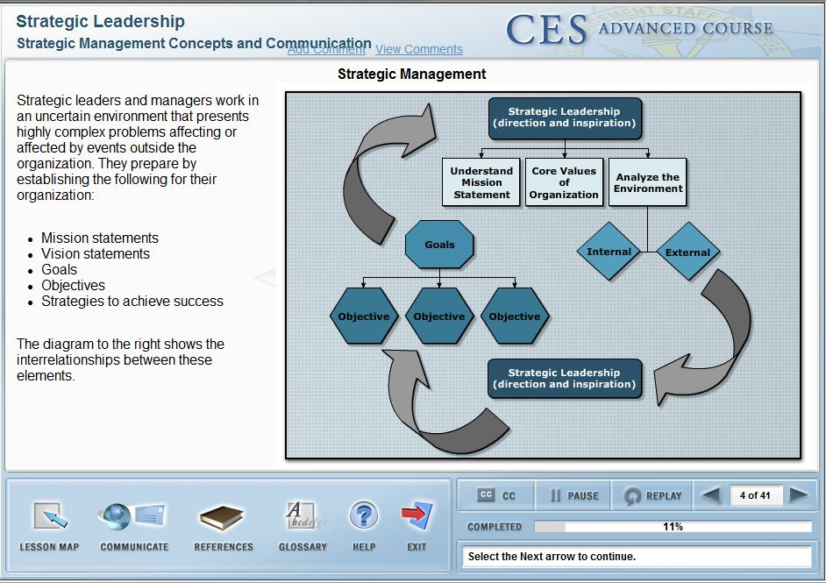
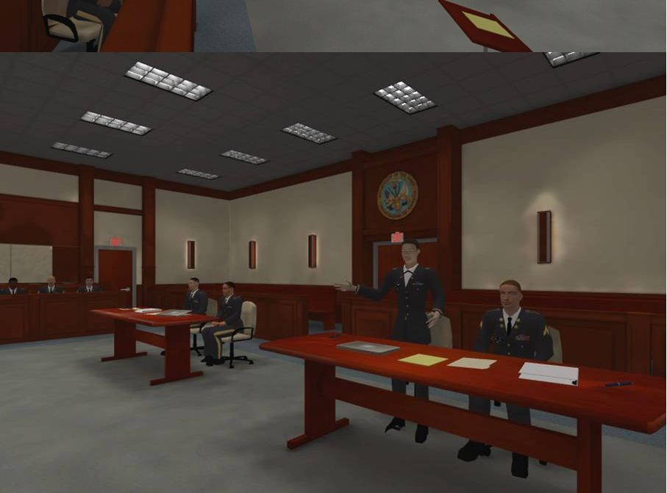
Designing for Reusability
  Over 20 years experience
Notes:
Purpose: Discuss the fact that C2 has a long history of designing, developing, and delivering training products.
Discussion:
An effective system for reusability has been in place to facilitate reusability for interactivity levels 1 – 3.
C2B with its templates, CSS layout, and themes
Transition: Industry moved to simulation and gaming as best practices for adult instruction
Challenge: How to apply reusability in developing simulations and games.
Images: Run animation of courses representing interactivity levels 1 -3 that C2 has delivered.

Slide 4
Objectives
At the conclusion of this presentation, you will:
Recognize flexible design strategies
Identify instructional systems design concepts that lend themselves to reusability
Recognize ways to create and use tools that facilitate rapid development and reusability
Recognize ways to customize commercial off the shelf products for reusability
Discuss the benefits of designing for reusability
Notes:
Use JAG projects as basis for assertions

Slide 5
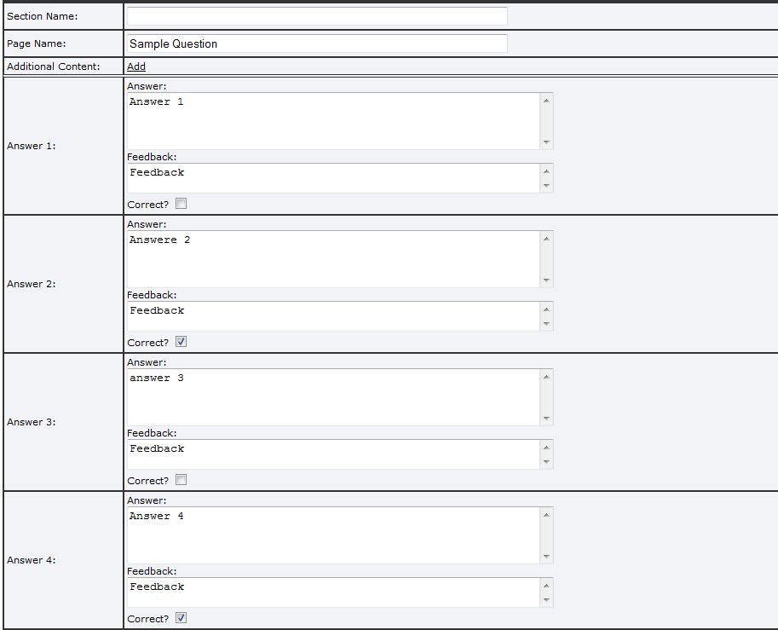
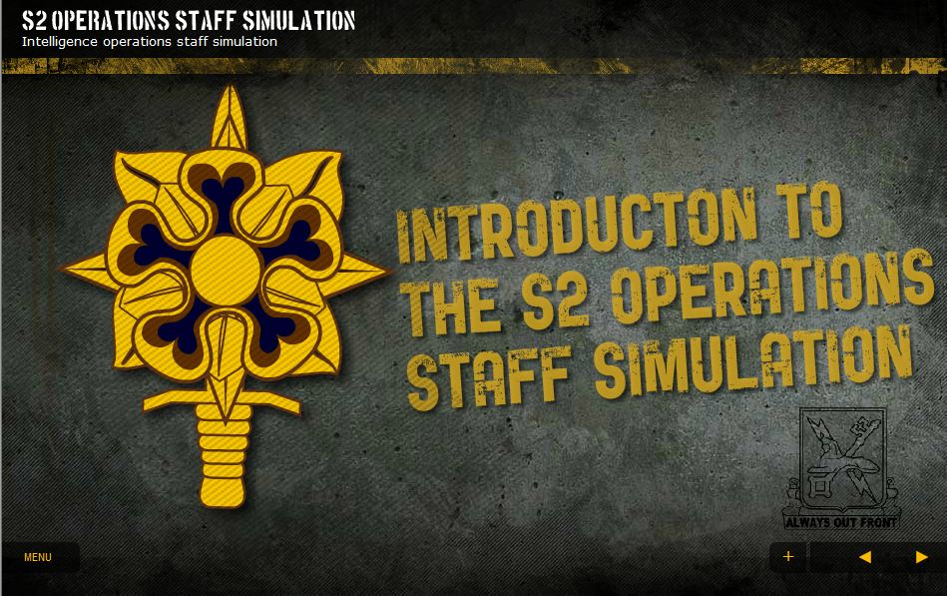
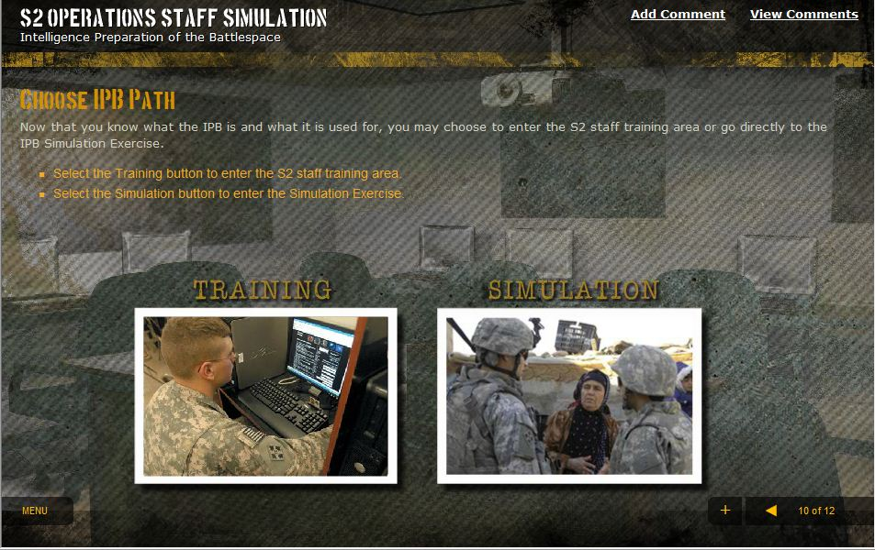
What’s Different About This?
Design the end product
  Design Templates for common screens/activities
Notes:
Discussion
In Levels 1 -3 online training
Identify and develop common screens and activities - CLICK
Examples include Intro and conclusions- CLICK
check on learning activities- CLICK
branching activities- CLICK FOR NEXT SLIDE

Slide 6
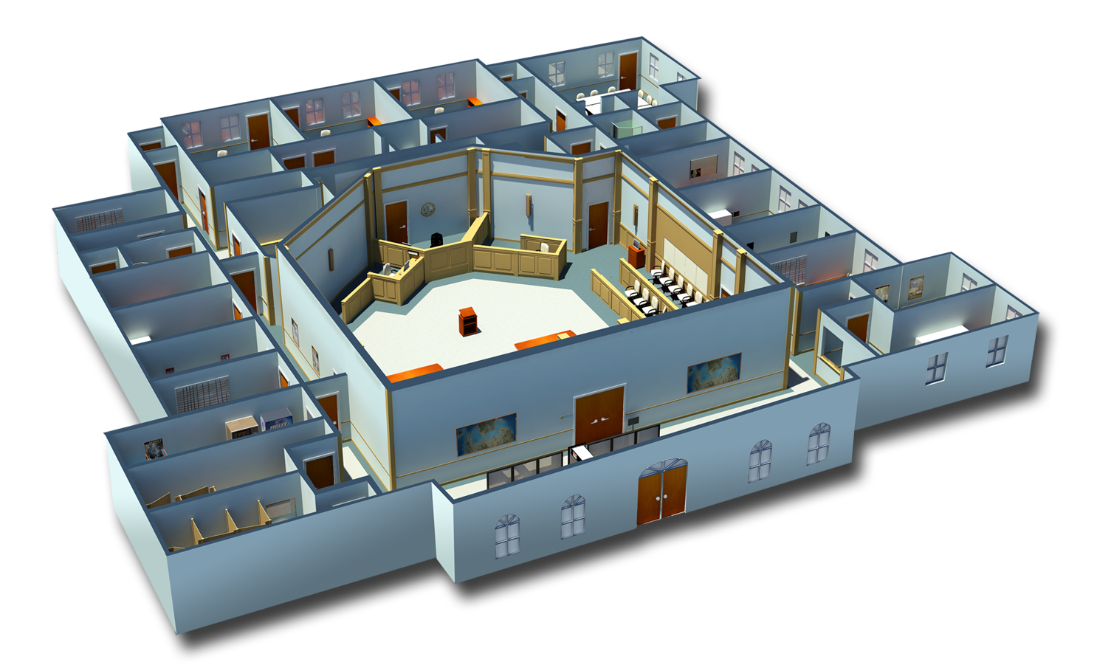
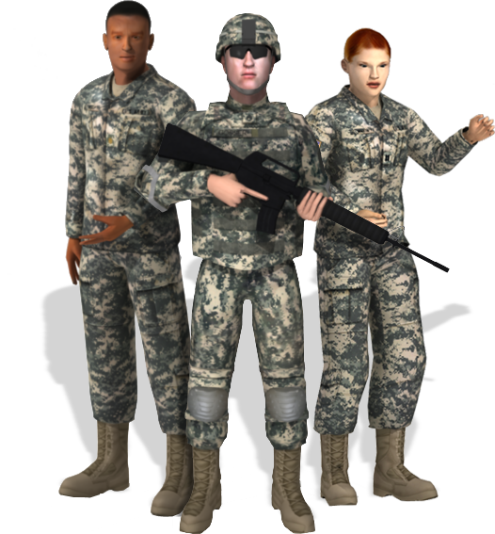
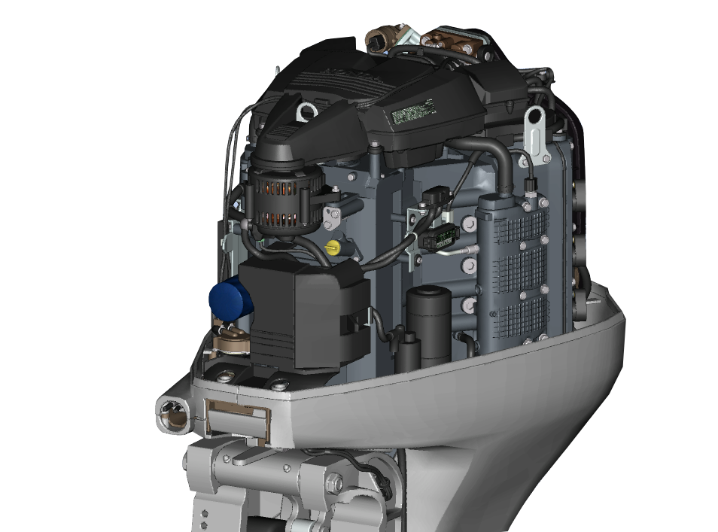
What’s Different About This?
Design the end product
  Design environments, avatars, and objects
Notes:
In simulation and gaming, instead of designing templates, - CLICK
we design environments, - CLICK
avatars, - CLICK
and objects. - CLICK FOR NEXT SLIDE

Slide 7
Flexible Design Strategies
Roles
Tasks
Environments
Interactions (animations)
Notes:
We applied these design strategies for the Judge Advocate, Bridge Construction, and Patriot simulations.
We will discuss and provide examples of each of these.

Slide 8
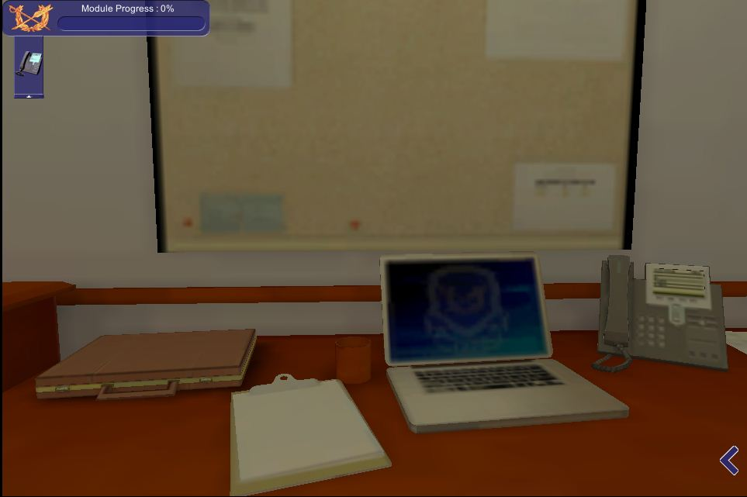
Flexible Design Strategies
Example 1
Role
  Office Manager
Tasks
  Coordinating, communication
Environment(s)
  Office, automation equipment
Interactions
  Face-to-face interactions, responding to emails and phone calls
Notes:
Identify the role’s environment, tasks, and interactions
Example 1:
Role is office manager. In our simulation this is the senior paralegal.
Tasks are coordinating and managing office activities
Environment is the office with normal automation and communication equipment
animations include standing, sitting, walking, talking, answering phones
Key point: using the 3 supporting requirements, the design strategy can be applied for any role.

Slide 9
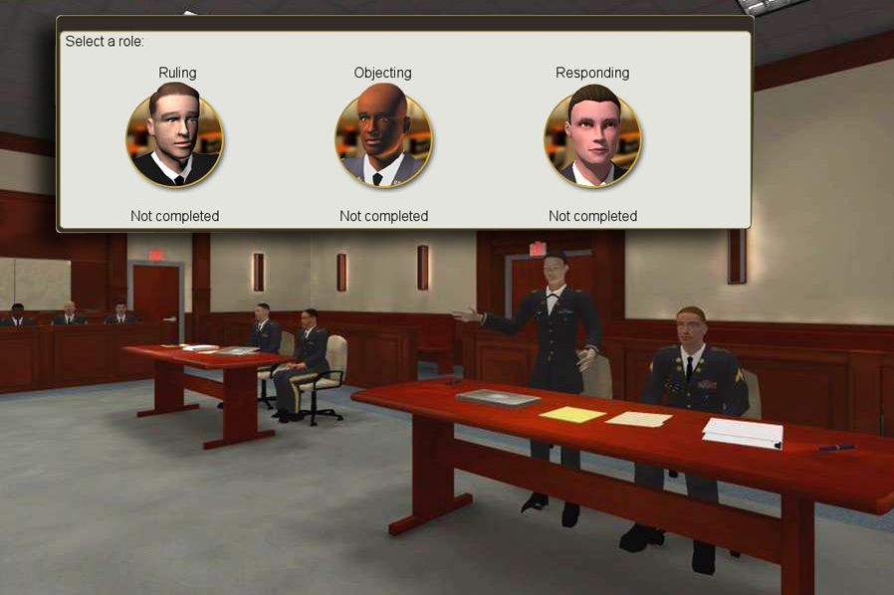
Flexible Design Strategies
Example 2
Role
  Judge, Attorney, Witness
Tasks
  Apply courtroom fundamentals
Environment(s)
  Courtroom, office, crime scenes
Interactions
  Face-to-face
Notes:
Identify the role’s environment, tasks, and interactions
Example 2:
Role is attorney
Tasks are to apply courtroom fundamentals
Environment is the courtroom, legal offices, and crime scenes
Animations standing, walking, sitting, talking, general guestures

Slide 10
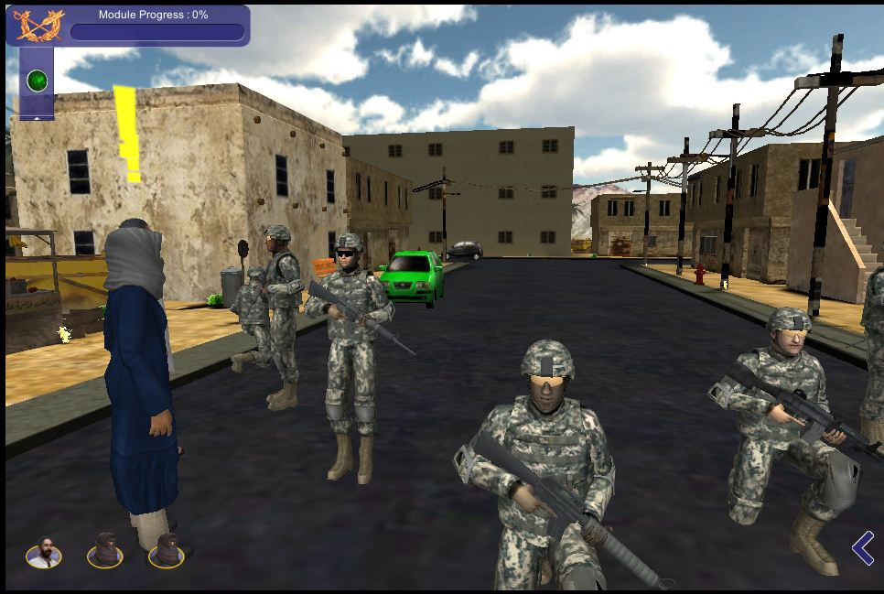
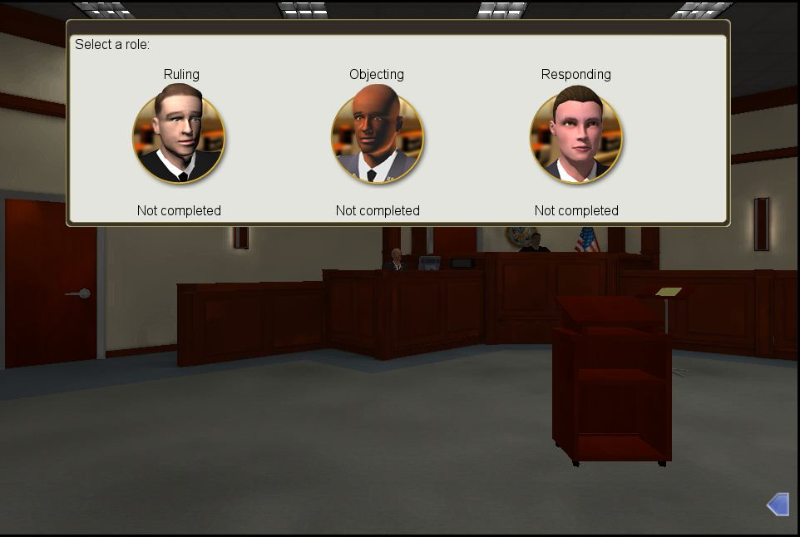
Flexible Design Strategies
Individual and Team Learning Example
Single user with simulation making team responses
Modify for multiplayer interaction
Notes:
In this example, there is a team of 9. this simulation is designed with the simulation performing the activities for the remaining 7 members. With minimum resources, this simulation may be modified for multiple players.
Transition:

Slide 11
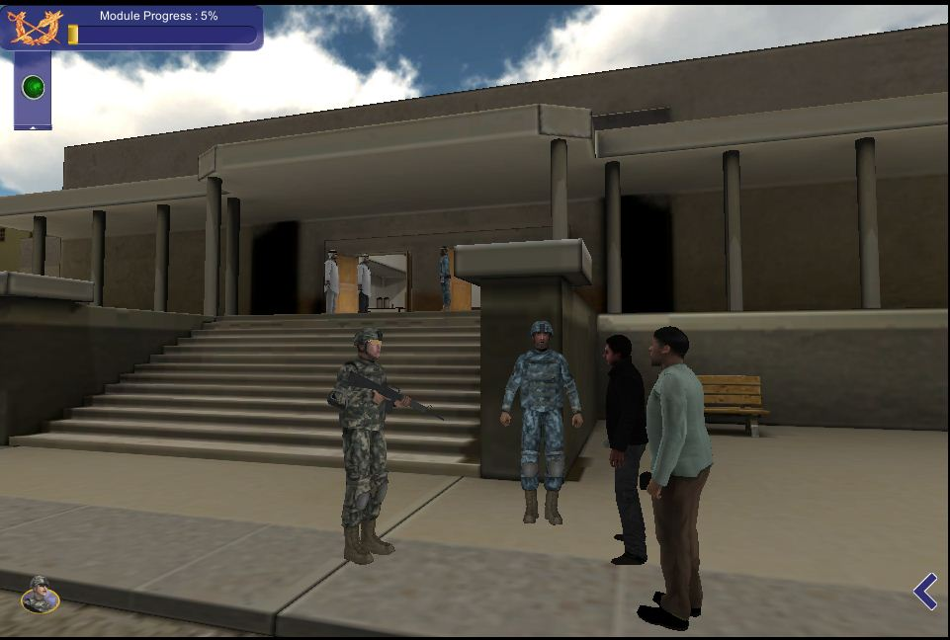
ID Concepts and Reusability
Immersion
Scene setting
Feedback
Performance summaries
Notes:
Discussion

Slide 12
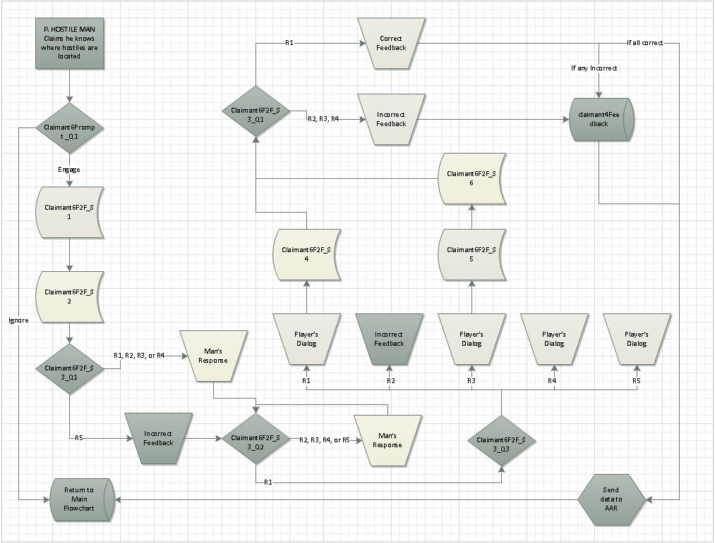
Tools to Facilitate Rapid Development
Process flowcharts

Slide 13
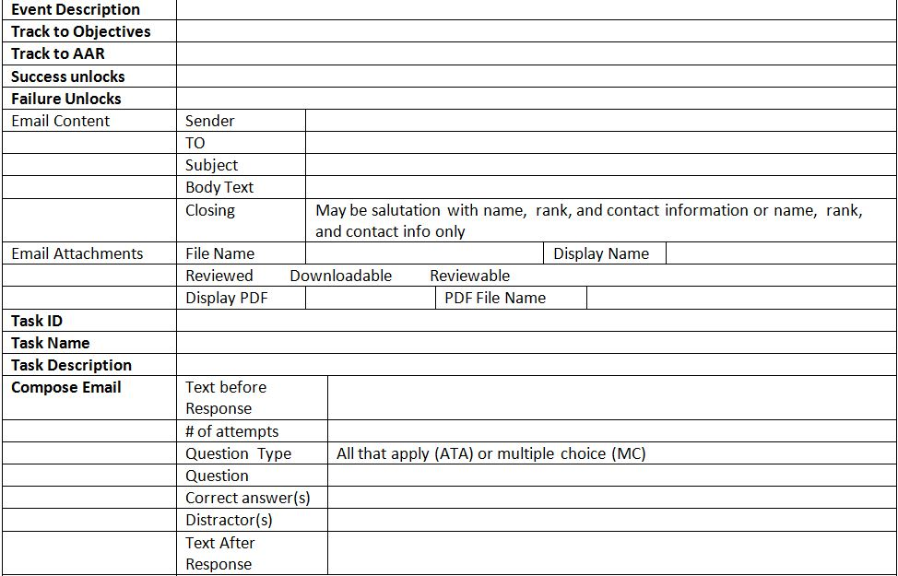
Tools to Facilitate Rapid Development
Script templates

Slide 14
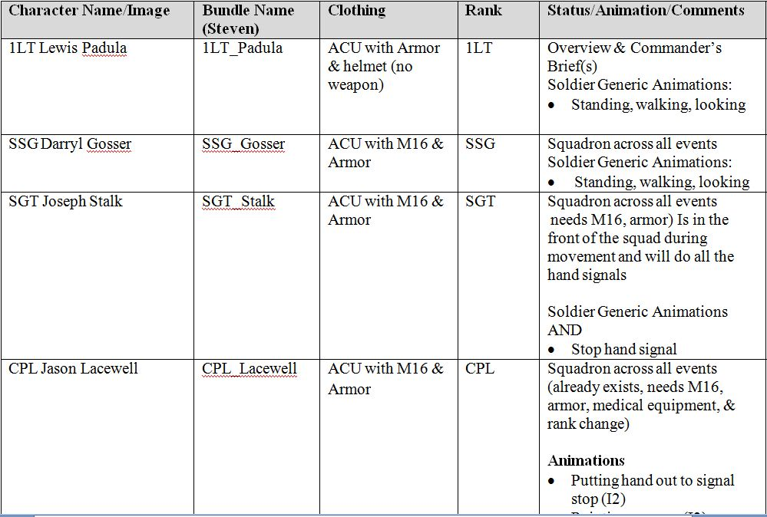
Tools to Facilitate Rapid Development
Asset Development Tracking

Slide 15
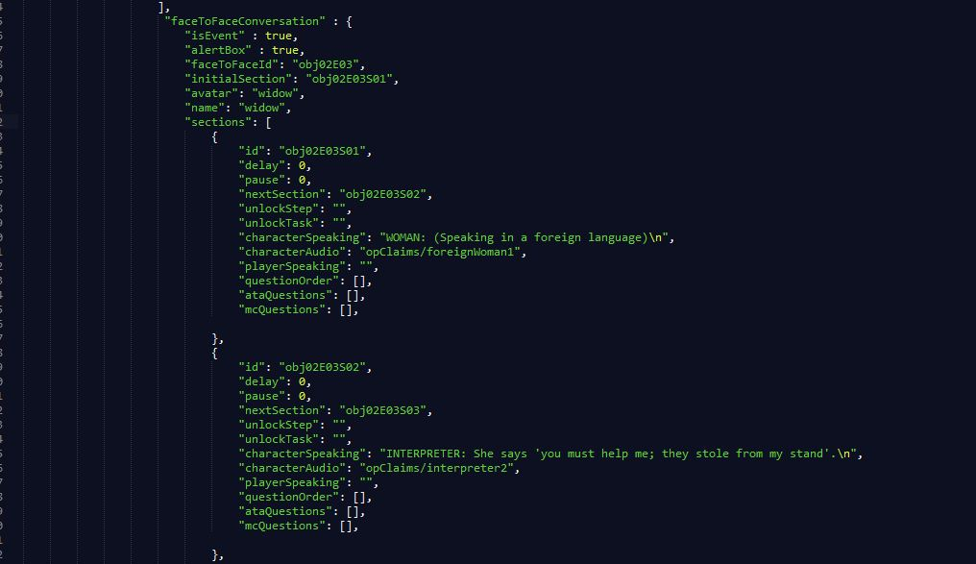
Tools to Facilitate Rapid Development
XML Files
Objectives
Tasks
Documents
Audio
Simulation Brain
Notes:
XML files are simply text files that control the simulations.
Initial shell developed by Unity Programmer
All content, graphics, audio, documents called by XML file
Controls
Branching – which activity or series of activities unlocks upon success or failure
Dialog between avatars
Audio, documents
questions

Slide 16
Content Structure
Folders for each type of asset
  Activities: XML files
  Audio
  Images
  Questions
  References
  Scenarios
  Videos
Notes:
Folder structure aggregates files to allow
Quick development
Easy location for maintenance

Slide 17
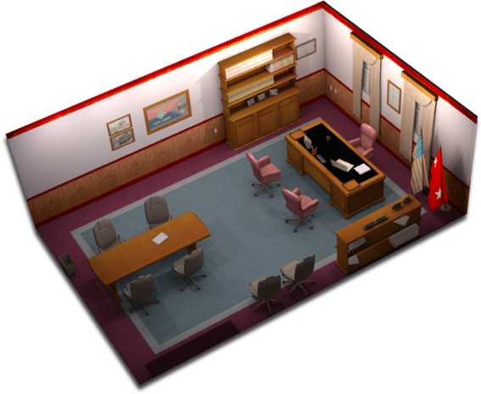
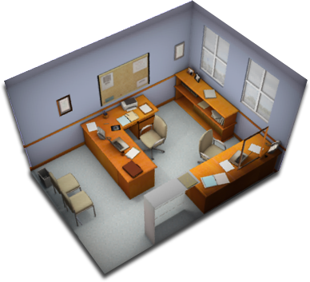
Graphic Development Products
AutoDesk 3D Studio Max – Reusable Geometry
Notes:
Discussion
Create complex 3D facility
Capture geometry for individual rooms, offices, objects and save as new file

Slide 18
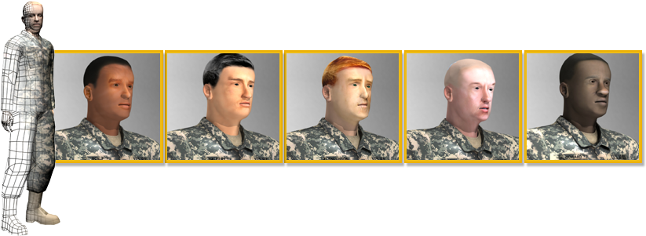
Graphic Development Products
AutoDesk 3D Studio Max
Create baseline male and female avatar
  Change texture to create new avatar
Notes:
Discussion
Numerous avatars in same attire – military uniform in this case
Create base avatar with all required uniform items – this may be 3 - 4 different maps depending on the level of detail required.
Save base avatar
Create textures and apply to base avatar
Instead of 1 avatar, we have 6 avatars.

Slide 19
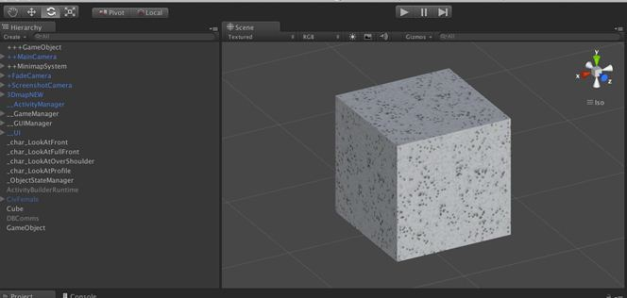
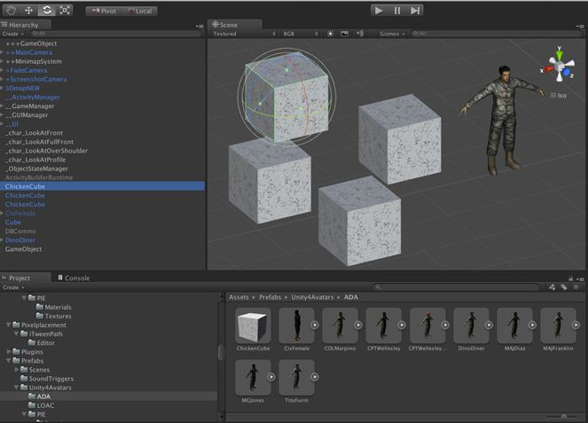
Unity Products
Prefabs – backbone of Unity Reusability
15 – 20 minutes to create a single avatar
  Animation
  Sequence
  Location
Duplicate avatars
Within or across simulations
Editable on the fly

Slide 20
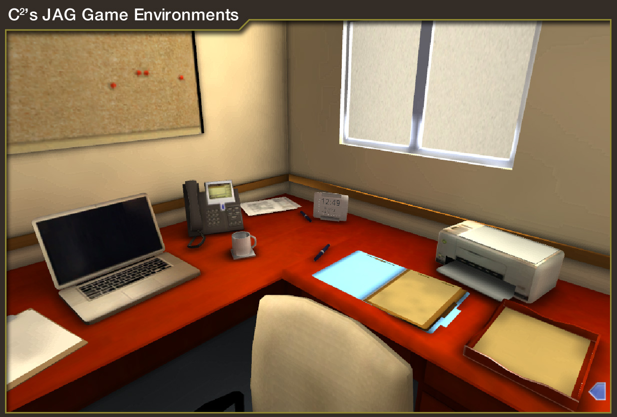
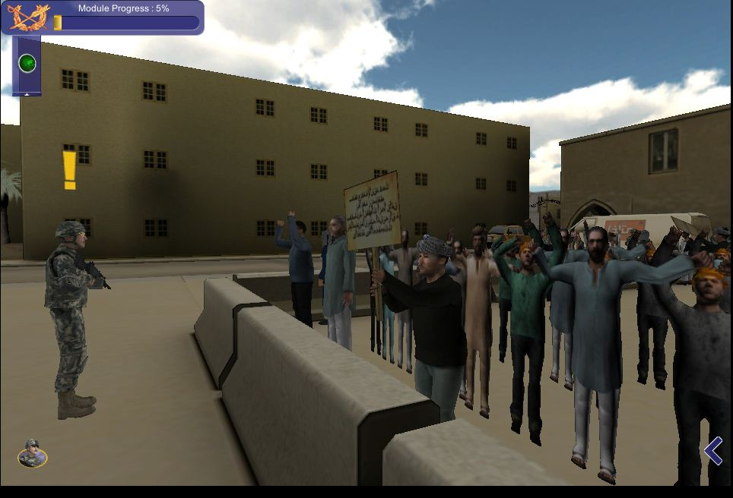
Unity Products
Create bundles
  Instance of avatar or environment
  Used to replace avatar/scene
  Editing more labor intensive than for Prefabs

Slide 21
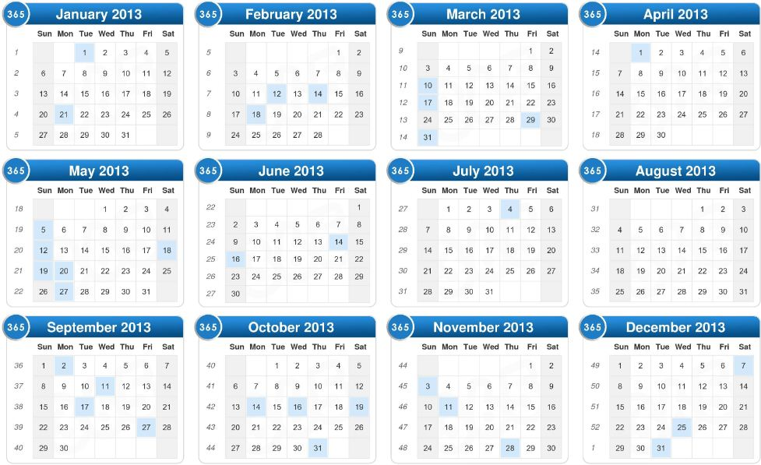
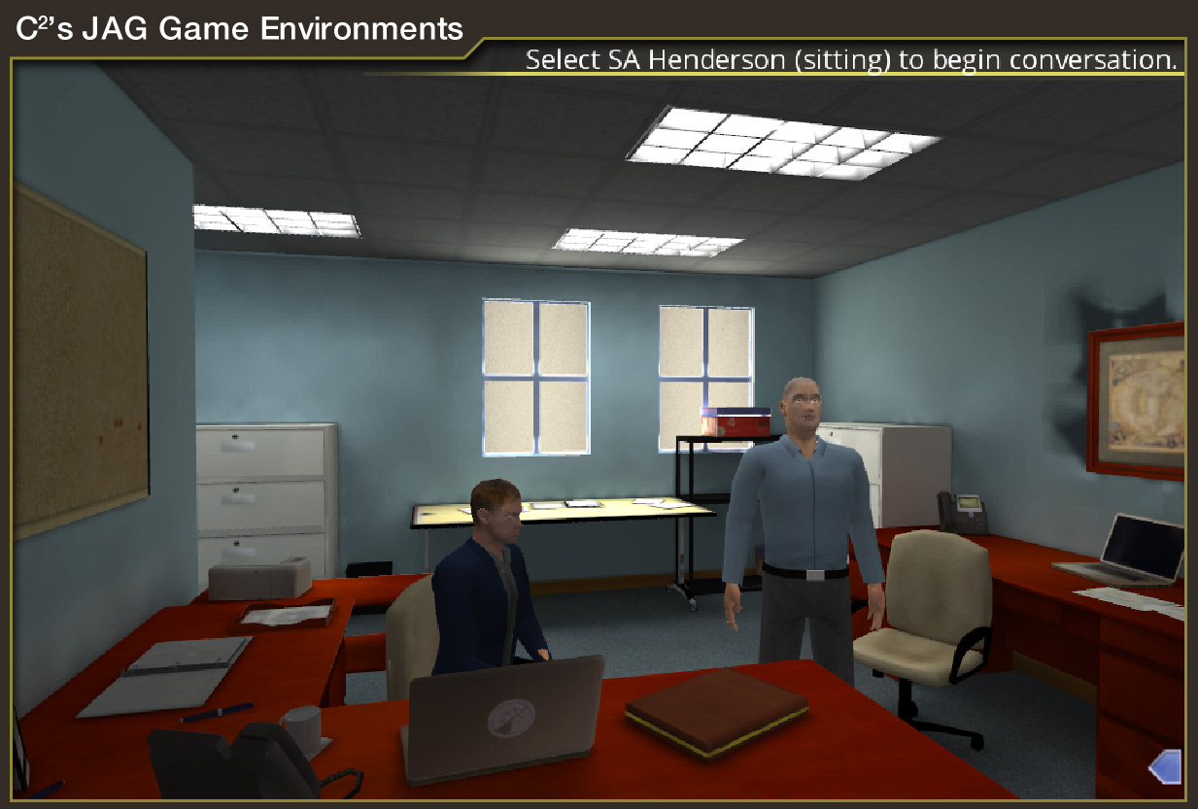

Benefits - Development Team
Reduce development time
Present consistent look and feel
Provide ability to make rapid updates
Notes:
Reduce development time
Allow instructional designers to perform much of the development previously performed by programmers
Consistent look and feel
Ability to make rapid updates

Slide 22
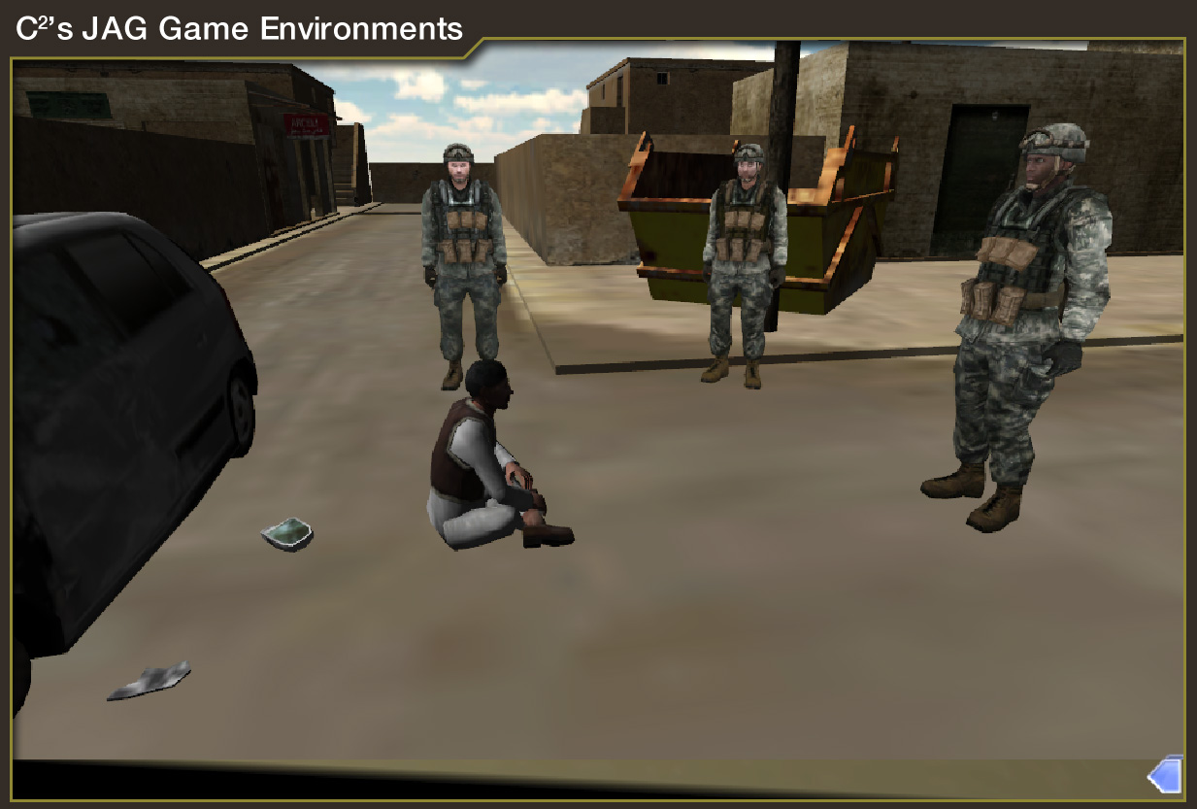
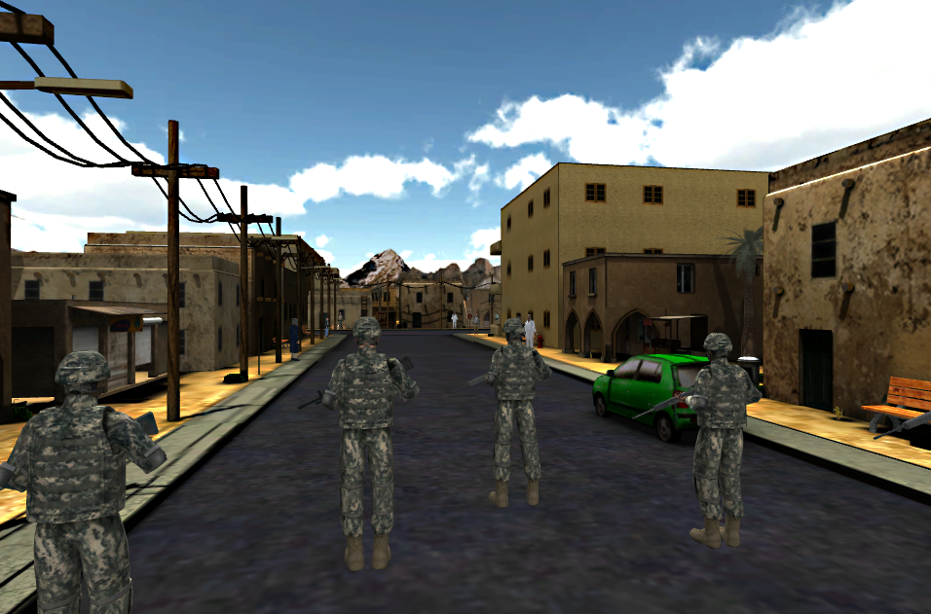
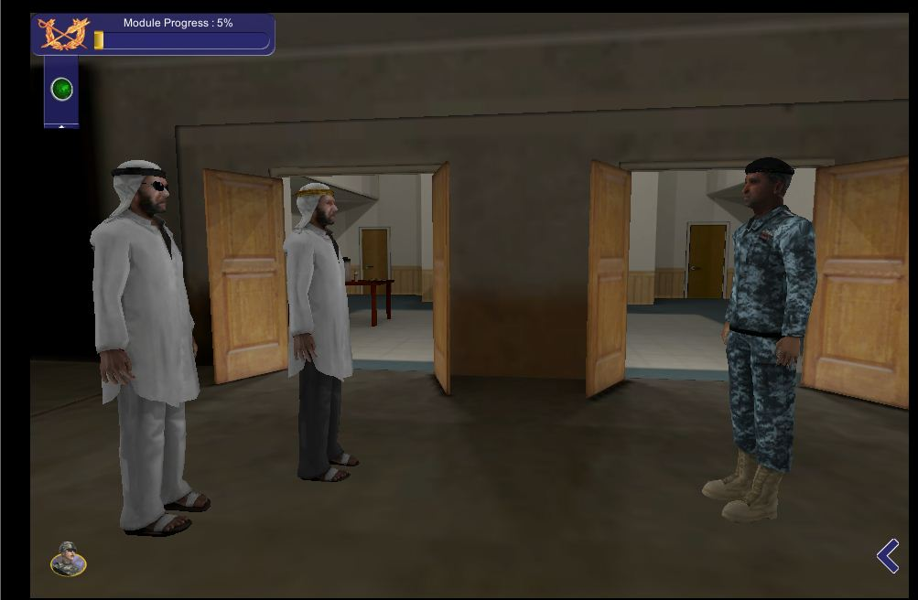
Benefits - Customer
Ability to maintain the product
Ability to add objectives/activities to product
Life of product is extended
Notes:
Discussion
Ability to maintain the product – important because laws and legal processes change frequently. Product delivered in October 2013 already changed and customer made modifications and replaced for student use in February this year.
Maintenance with layman skills - only need basic office skills
Replace content by editing the XML
Replace images, documents, audio by replacing appropriate item in the folder
Ability to add new objectives/activities to product
Life of product is extended

Slide 23

Contact Information
Gayla Thompson, Senior Project Manager
gthompson@c2ti.com, 757-595-4169
Darlene Smith, Senior Task Lead
dsmith@c2ti.com, 757-401-6402
C² Technologies, Inc.
www.c2ti.com

