Slide 1

Phishing – Are You Getting Hooked?
Notes:
Today we are focusing on cyber security from the perspective of phishing because they are the cyber attacks and incidents we are seeing. We’ll talk about some ways you can address this through training.

Slide 2
Facilitators
Janet Wilson, Project Manager C² Technologies
  Instrumental in developing cyber-security awareness training and communication for Federal Clients
Mike Webber, Consultant C² Technologies
  Specializes in cyber-security services and training
Notes:
Janet Wilson, Program Manager, C² Technologies
As a Program Manager for C² Technologies, Ms. Wilson has been instrumental in the development of cyber-security awareness training and communication for Federal Government clients. A PMP since 2005, she received her B.S. from Berry College (Mathematics) and an M.A.T. from Georgia State University (Teaching).
Michael Webber, Senior Vice President, BitSec Global Forensics
Michael Webber specializes in cyber security services and training, providing expert guidance to C²’s Veterans Affairs and Department of State clients. Before, becoming a cyber-security trainer, Mr. Webber served as a sworn law enforcement officer with a focus on cybercrime for over twelve years. In addition to assisting government and corporate clients with issues surrounding electronic discovery, digital forensics, and data breach investigations, he has developed and provided cyber training in over 26 countries. Mr. Webber is currently a Senior Vice President of Technology with BitSec Global Forensics, a division of Network Designs, Inc. (NDi), a Service Disabled Veteran Owned Small Business (SDVOSB).

Slide 3
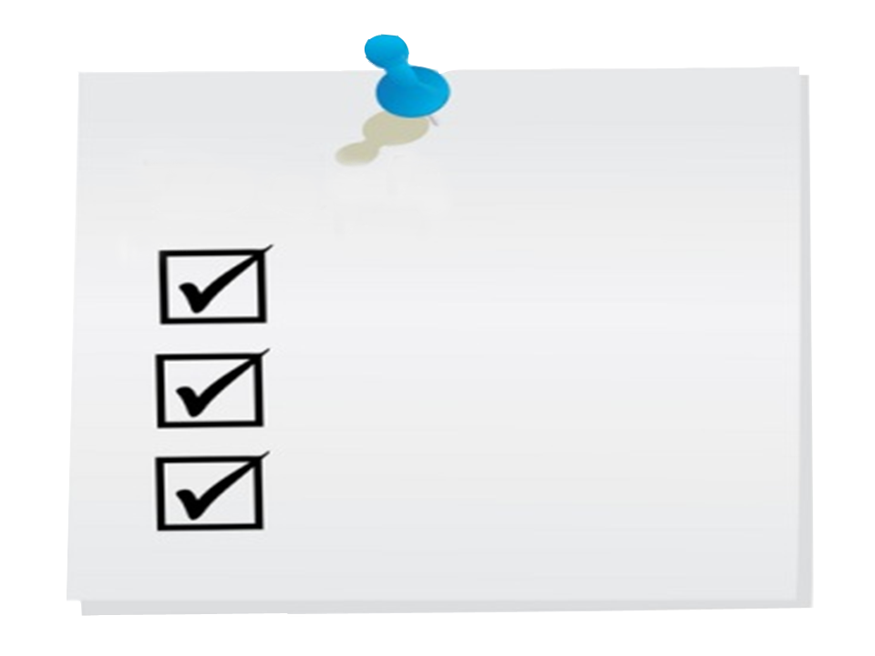
Discussion Topics
Case Studies
Profiles of a Present-Day Attack
Continuing Education
Notes:
2011 reports to U.S. CERT was that over 53 percent of all incidents report initially targeted the employee not the systems. Corporate American saw a 1 percent decrease in overall attacks, where the U.S. government saw a 5% increase.
Discuss cases where phishing attacks were used against the U.S. Government
Discuss how present-day attacks work
Discuss the need to educate users continually
Participants in this session will be able to:
Examine the emphasis on security to reduce the number of successful attacks
Identify tools that attackers use to exploit vulnerabilities
Discuss ways to engage the workforce

Slide 4


Slide 5
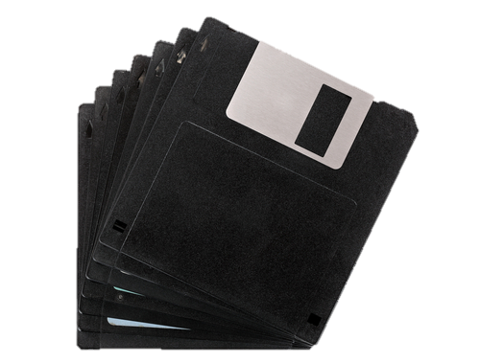
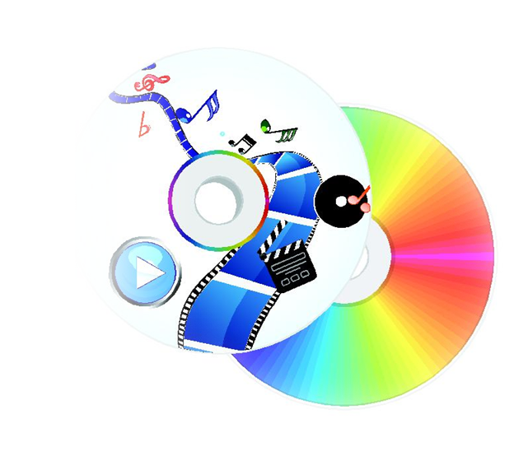
Not All Threats Are External!
Notes:
Not all threats are external and not limited to the United States. According to reports, in July 2007 Jeffery Delisle walked into the Russian Embassy in Ottawa and offered to sell secret information to the Russian military intelligence service. He didn’t email or upload information, he didn’t use an USB (they were locked down). So, he used a floppy disk. He found an older system that still had a floppy disk enabled. Transferred the info to a floppy, eventually found a system that allowed him to transfer the info to a USB then left the area. The techniques Jeffrey Delisle, of the Canadian Navy, used were antiquated in terms of today’s cyberworld sophistication. The problem was nobody though the floppy disk would be a problem.
At court in October 2012 Delisle pleaded guilty to breach of trust and two counts of passing secret information to a foreign entity, contrary to the Security of Information Act. He was sentenced to 20 years in penitentiary, minus time served, by the Chief Judge of the Provincial Court of Nova Scotia on February 8, 2013.
Bradley Edward Manning is a United States Army soldier who was arrested in May 2010 in Iraq on suspicion of having passed classified material to WikiLeaks. It was childishly easy, according to the published chatlog of a conversation Bradley Manning, had with a fellow-hacker. “I would come in with music on a CD-RW labeled with something like ‘Lady Gaga’…erase the music…then write a compressed split file. No one suspected a thing…[I] listened and lip-synched to Lady Gaga’s Telephone while exfiltrating possibly the largest data spillage in American history.” He said that he “had unprecedented access to classified networks 14 hours a day 7 days a week for 8+ months.”
The material included videos of the July 12, 2007 Baghdad airstrike and the 2009 Granai airstrike in Afghanistan; 250,000 United States diplomatic cables; and 500,000 army reports sometimes called Iraq War logs and Afghan War logs. It was the largest set of restricted documents ever leaked to the public. Much of it was published by WikiLeaks or its media partners between April and November 2010.
On February 28, 2013, Manning pled guilty to 10 of the 22 charges against him, which could carry a sentence of up to 20 years. One notable charge for which he did not enter a plea is the charge of "aiding the enemy", which could carry a life sentence. The judge must choose if she will accept the pleas; prosecutors will pursue a court martial on the remaining charges.
CD’s locked down?

Slide 6


Notes:
A data entry clerk who has access to people’s social security numbers, dates of birth, phone numbers, etc. are more likely to be targeted than those with access to classified data just because of the commercial viability of the information.
Open Source Intelligence Gathering
The trusted employee
CFO (according to LinkedIn)
“I got a new camera” (posted to Facebook)
Receives email from CFO (purportedly) about updated manual (CFO was a camera buff too)
Manual (PDF) contained an exploit that captured her passwords (and the CFOs)
4-5 days later starting on a Friday evening once everyone had gone home, transfer of over $1 million went to a bank in another country.
She was targeted because of her position. Simple email apparently from someone in the company.

Slide 7

Notes:
So, what can be done?
In 2011, DHS seeded a U.S. Government agency parking lot with thumb drives. 60% of the thumb drives were inserted into a government system. When they did the test the second time, this time adding a government logo to the thumb drive 90% were inserted.
Email is also an easy way to test. This test operation targeted 3,000 employees by offering them something fun in email. The email also had some red flags.
Within two hours, the testers had to stop the operation because they had over 1,000 employees click on the link in the phishing email, despite the red flags that they had put into the message.
From that point on, the company used the experience as a teaching tool from that point on to emphasize the need to be on guard.

Slide 8
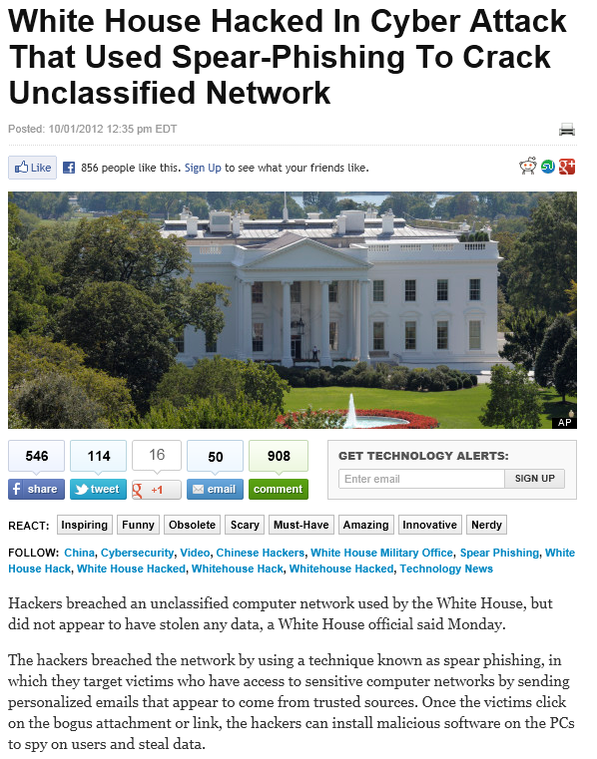
Malware is Easy to Detect
Phishing….Not so much….
51% of all attacks on .GOV systems are Phishing (US-CERT)
Notes:
Phishing is difficult to detect.
51% of all attacks on .GOV systems are Phishing (US-CERT)
October 2012 -- Official confirms report by veteran Pentagon reporter Bill Gertz saying hackers linked to China's government "broke into one of the U.S. government's most sensitive computer networks.“
The White House has confirmed that one of its internal computer networks -- reportedly a military office in charge of the president's communications -- has been targeted in a successful "spearphishing" attack.
An article published by the conservative FreeBeacon.com Web site said that hackers with ties to China's government had breached an unclassified "system used by the White House Military Office for nuclear commands," including the so-called nuclear football.
Spearphishing means an attacker is targeting a specific person or group, typically by sending fake e-mail that masquerades as legitimate correspondence.
Unidentified hackers believed to have used computer servers in China to access the computer network used by the White House Military Office, the president's military office in charge of some of the government's most sensitive communications, including strategic nuclear commands.“ No classified networks appear to have been breached.
If the reports are accurate, this intrusion would be the latest round in a clandestine cyberwar that has been raging for the last few years between the United States and China.

Slide 9
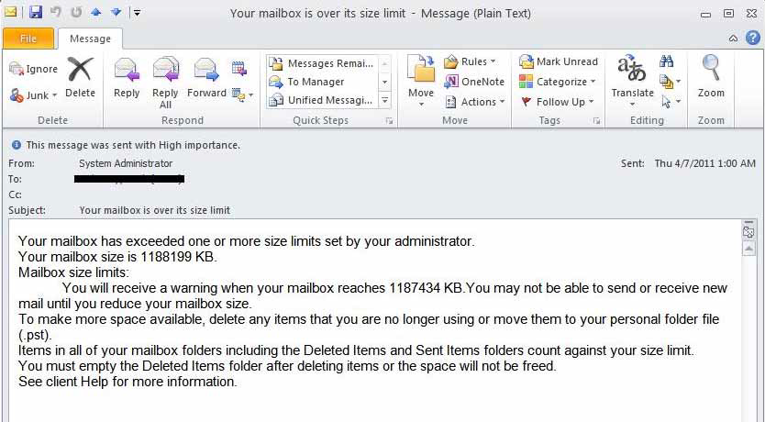
Notes:
Not always easy for users to detect
Mail box size limit messages
“Fraud detected” emails
Not just technological
Upswing in “cold calls”
From IT
From Microsoft!
USB devices left in parking lots
USB is a tech tool, but used in a non-tech way
“I am writing a book!”
2011 DHS seeded an U.S. Gov. parking lot
60% inserted into a government system
90% when a logo was used

Slide 10






Profiles of a Present-Day Attack
Notes:
Present day attacks are less about technical vulnerabilities and more about human vulnerabilities.
These attacks make the trusted individual a willing participant in the attack.
Some of the tools used in present day attacks include:
Google
spoofApp
Social Networking sites like LinkedIn
Maltego3
Backtrack
And the Social EngineeringToolkit

Slide 11
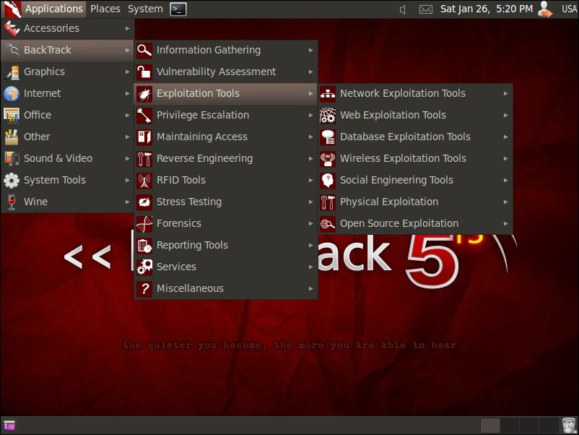
Backtrack
Swiss Army Knife of Attack Tools

Slide 12
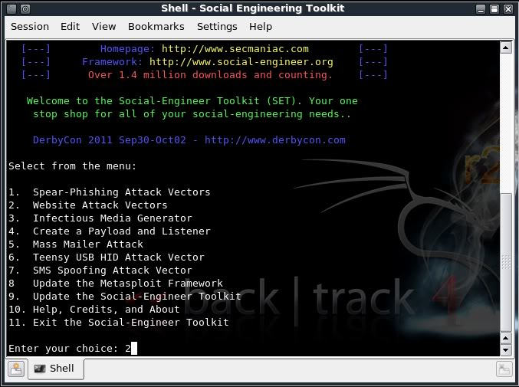
Social Engineering Toolkit
“Because there is no patch for stupidity”

Slide 13
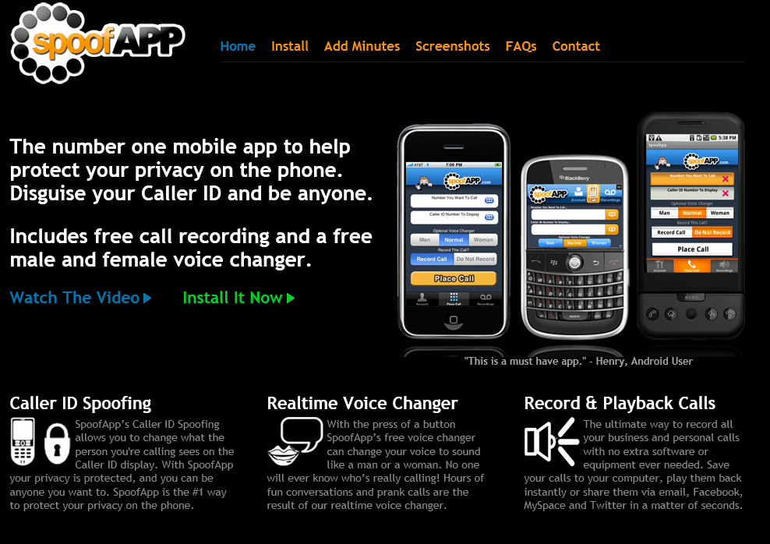
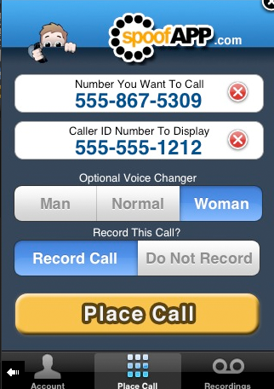
Caller ID Spoofing
“there's an app for that”

Slide 14

Notes:
Loose estimates attribute at least 50% of phishing targeted at USG agencies to Advanced Persistent Threats (APT)
At most agencies, each phishing campaign nets AT LEAST one user
No malware payload required
Just a .GIF with a crafted pixel that tells the attacker who opened the message is enough. From that, they glean the users IP address, computer location, browser and OS info, etc.
Why? -- Desensitization
Users overwhelmed
Apathy
Dulled awareness
Lack of reporting

Slide 15
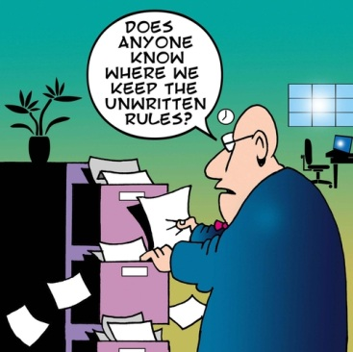
Notes:
People in your organization need to be educated regarding your policies for information security.
They also need to know what is going on in terms of information security. What are the current trends?
Scenario based learning can provide a wonderful opportunity for people in your organization to test their skills in a low risk environment.

Slide 16

Notes:
Pen-testing employees can be used as an education tool
Done properly it can educate employees, ISO, and decision makers about ACTUAL risks to an organization as well as allow for better implementation of controls
Done improperly, it can anger users or promote a “no-win” atmosphere
Outside vendors provide packaged solutions; or
It can be undertaken in house
Protocols and full buy in are essential
Tools like Metasploit or SET enable attackers and security professionals alike to conduct phishing operations

Slide 17

Notes:
Set background to transparent.

Slide 18
C² Technologies
www.c2ti.com
1921 Gallows Road, Vienna, VA 22182
jnwilson@c2ti.com

